Slide 1






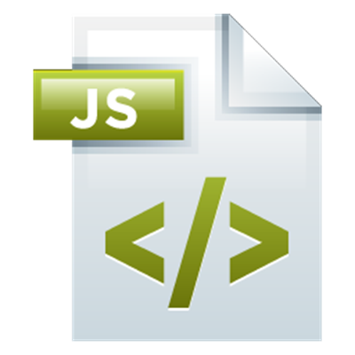
Modules & Routing
Making big SPA applications
Angular Development
SoftUni Team
Technical Trainers
Software University
http://softuni.bg

Slide 2

Table of Contents
Bootstrapping an application
The root module
The NgModule
Using built-in modules
Creating your own modules
Routing & Navigation
Creating our SPA

Slide 3
Have a Question?
sli.do #angular-js

Slide 4
Bootstrapping An Application
From where the Angular app starts

Slide 5
Bootstrapping An Application
An NgModule class describes how the application parts fit together
Every application has at least one NgModule – the root module
It is used to bootstrap the application
Usually, it is called AppModule but it is not necessary

Slide 6
Bootstrapping An Application
The initial AppModule
import { NgModule } from '@angular/core';
import { BrowserModule } from '@angular/platform-browser';
import { AppComponent } from './app.component';
@NgModule({
imports: [ BrowserModule ],
declarations: [ AppComponent ],
bootstrap: [ AppComponent ]
})
export class AppModule { }

Slide 7
Bootstrapping An Application
The imports array – adds functionality from other modules
For example – BrowserModule, HttpModule, FormsModule, etc.
The declarations array – registers components to be used in this module
For example – HomeComponent, ListCarsComponent, etc.
The bootstrap array – the root component, which Angular will insert into the index.html file

Slide 8
The NgModule
What is an Angular module?

Slide 9
The NgModule
Modules organize applications
Many libraries are modules (HttpModule)
Contain components, directives and pipes with similar features
Modules add global services to an application
Can be loaded eagerly on application start or asynchronously by the router
Each application has at least one module – the root module
As the application grows – you add different feature modules into the root module

Slide 10
The NgModule
Creating custom modules
import { NgModule } from '@angular/core';
import { CommonModule } from '@angular/common';
import { FormsModule } from '@angular/forms';
import { SomePipe } from './some.pipe';
import { SomeComponent } from './some.component';
import { SomeService } from './some.service';
import { SomeDirective } from './some.directive';
@NgModule({
imports: [ CommonModule, FormsModule ],
declarations: [ SomeComponent, SomeDirective, SomePipe ],
exports: [ SomeComponent ],
providers: [ SomeService ]
})
export class SomeModule { }

Slide 11
The NgModule
Suggested common modules
SharedModule – to contain all common components and directives used by a lot of places
CoreModule – to contain singleton services and components needed only once in the application
FeatureModule – to contain feature specific components
More info: https://angular.io/guide/ngmodule

Slide 12
Routing & Navigation
The core SPA feature

Slide 13
Routing & Navigation
First add the base meta tag into the index.html file
Second add the following into your HTML
Add routes.module.ts file
Add links
Extract parameters with (the non-observable options)
<base href="/">
<router-outlet></router-outlet>
<a routerLink="/about">About</a>
constructor (private route: ActivatedRoute)
let id = this.route.snapshot.paramMap.get('id');

Slide 14
Routing & Navigation
The routes configuration
import { NgModule } from '@angular/core';
import { RouterModule, Routes } from '@angular/router';
// Component imports…
const routes: Routes = [
{ path: '', component: HomeComponent },
{ path: 'about', component: AboutComponent },
{ path: '**', component: PageNotFoundComponent }
];
@NgModule({
imports: [ RouterModule.forRoot(routes) ],
exports: [ RouterModule ]
})
export class AppRoutesModule { }

Slide 15








JavaScript Web – Angular Fundamentals
https://softuni.bg/courses/angular-2-fundamentals

Slide 16

License
This course (slides, examples, demos, videos, homework, etc.) is licensed under the "Creative Commons Attribution-NonCommercial-ShareAlike 4.0 International" license
Attribution: this work may contain portions from
"End-to-end JavaScript Applications" course by Telerik Academy under CC-BY-NC-SA license

Slide 17





Free Trainings @ Software University
Software University Foundation – softuni.org
Software University – High-Quality Education, Profession and Job for Software Developers
softuni.bg
Software University @ Facebook
facebook.com/SoftwareUniversity
Software University @ YouTube
youtube.com/SoftwareUniversity
Software University Forums – forum.softuni.bg

